Slide 1

Bug Tracking System
Efficient Bug Management for Software Development Projects

Slide 2
Introduction
Overview:
A bug tracking system is an essential tool in software development, allowing teams to efficiently report, manage, and resolve issues.
This project aims to develop an online platform that facilitates communication and collaboration among testers, developers, and project managers.

Slide 3
Project Scope
Scope Summary:
The system will enable software testers to report bugs, project managers to assign bugs to developers, and developers to update the status of bugs.
All actions are tracked and documented, providing a clear history of bug resolution.
Key Features:
Bug reporting and tracking.
User roles: Testers, Developers, and Project Managers.
Project-specific bug management.
Severity level assignment for prioritizing bugs.

Slide 4
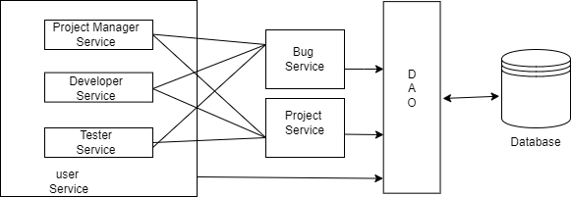
System Architecture

Slide 5
System Architecture
Layered Architecture:
UI Layer: Manages the user interface and interaction.
Controller Layer: Handles user requests and communicates between the UI and business layers.
Business Layer: Implements the core logic and manages data access.
Loose Coupling:
Each layer is designed to be independent, allowing changes in one layer without affecting others.
Enhances flexibility, scalability, and maintainability of the system.

Slide 6
User Interface Design
Pages Overview:
Registration and Login: Users register and log in to access the system.
Main Pages: Different main pages for Testers, Developers, and Project Managers.
Project and Bug Management: Pages for creating projects, assigning team members, and managing bugs.

Slide 7
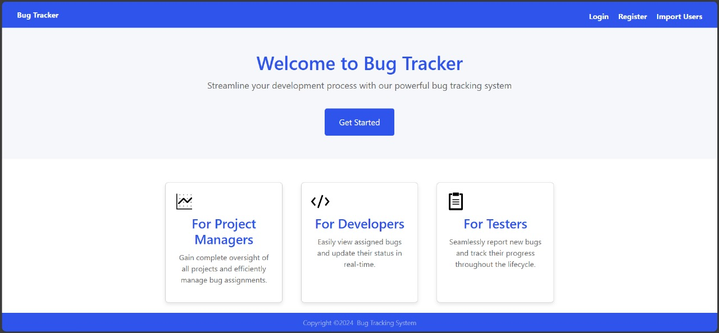
Home Page Overview
The home page will act as a central hub, providing access to various functions like user registration, login, and role-specific actions.
A consistent layout with a header, footer, and sidebar will be used to ensure easy navigation across all pages.

Slide 8
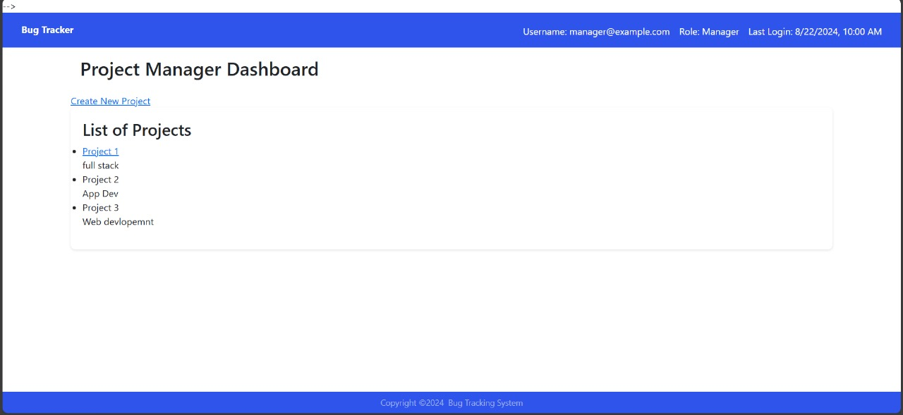
Project Manager Dashboard
In project Manager dashboard, the project manager can create the project and assigns bugs to appropriate developers and ensures timely resolution.

Slide 9
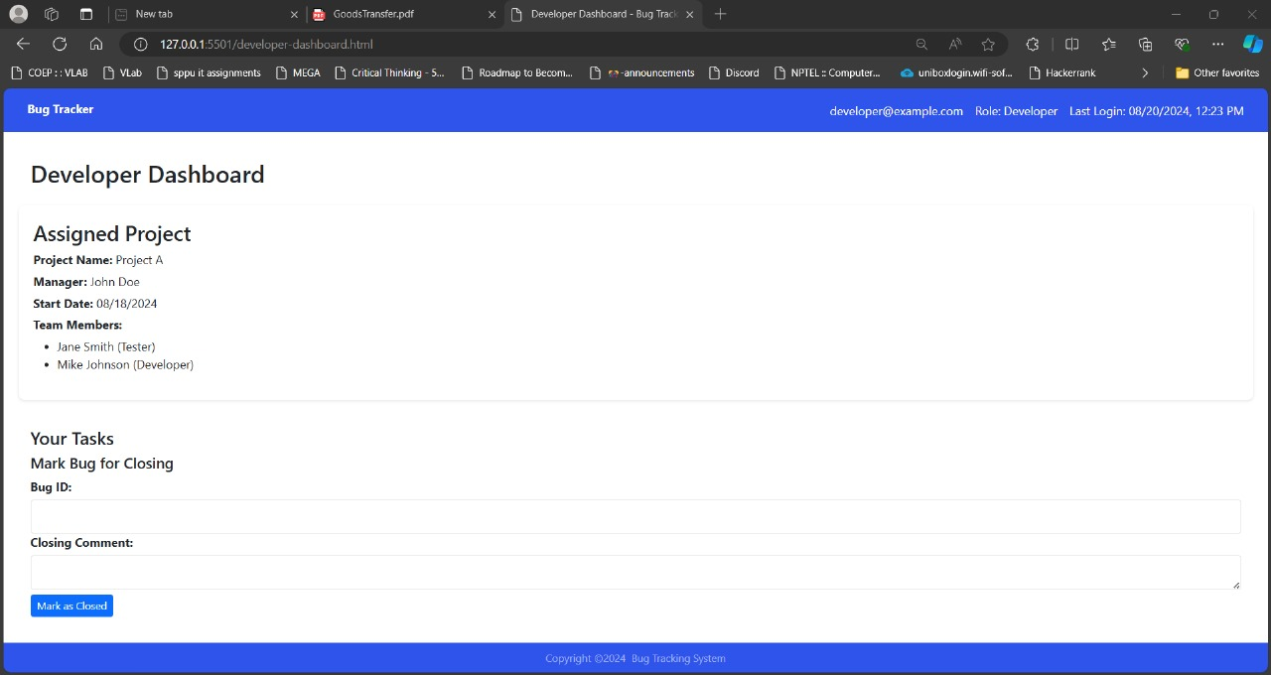
Developer Dashboard
In developer dashboard , the developer can see assigned project and bug related to it. Once he resolves the bug , he can close it accordingly.

Slide 10
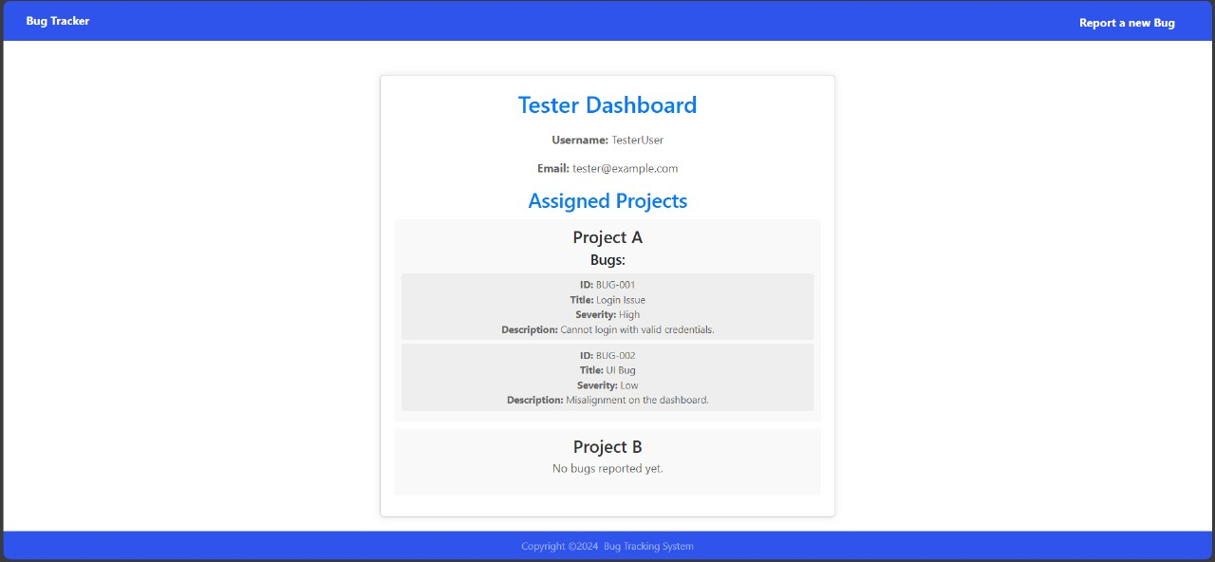
Tester Dashboard
In tester dashboard, the tester can see the assigned project and can report the bug accordingly.

Slide 11
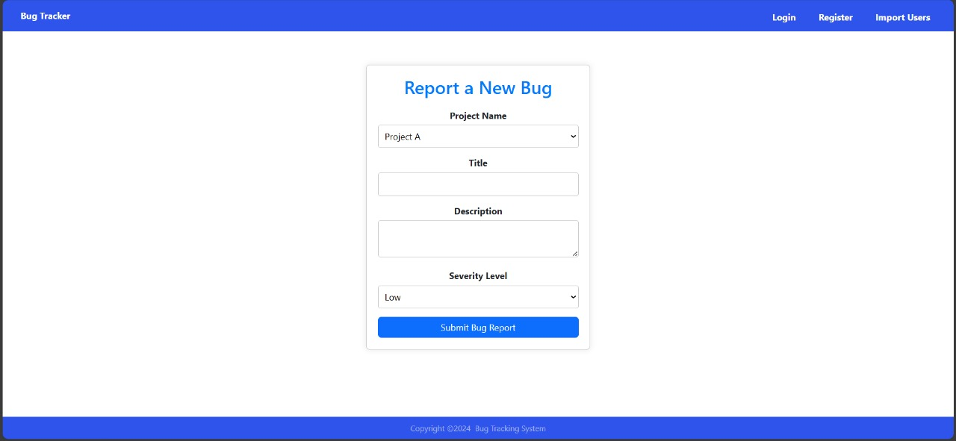
Bug Management
Bug Reporting:
Testers report bugs using a form that captures the Project Name, Title, Description, and Severity Level.

Slide 12
Conclusion
The Bug Tracking System provides a structured approach to managing bugs in software projects, ensuring efficient communication and resolution.
The system supports role-specific functionalities and tracks the entire lifecycle of a bug.

